Slide 1
To the presenter
Before using these slides, please be aware of the following:
The GOALS logo and Copyright information on the last slide must remain intact.
If you use the included video the following information must be included: “National Federation of the Blind 2011”
Feel free to modify this presentation. Because we are interested in seeing how others use the information please send us your version (goals@ncdae.org)
Please review the information provided in the notes panel throughout the presentation.

Slide 2
Implementing Institution-Wide Web Accessibility
Notes:
Add your own subtitle to this slide.

Slide 3

The Need
The internet has become an integral part of
higher education. The web is used by students, staff, and faculty alike for everything from online learning to critical administrative functions.
However, inaccessible websites can
inhibit or severely restrict the participation of some users with disabilities in postsecondary settings.

Slide 4
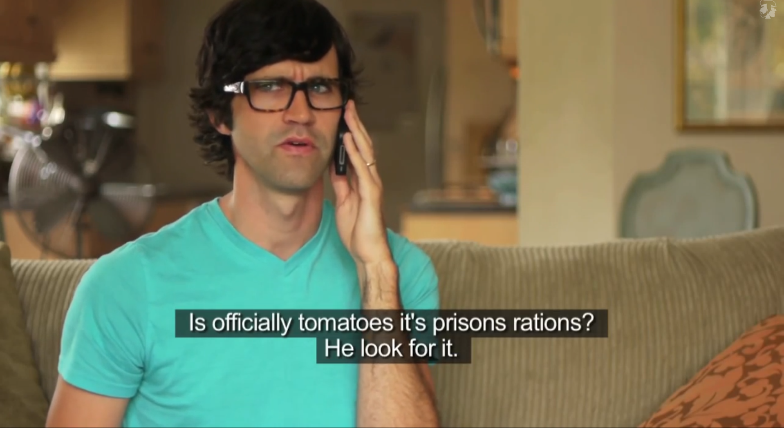
Accessibility???
Notes:
-This slide is provided as an icebreaker. It is a funny “Caption Fail” video. Click on the image to go to the YouTube video. If time is short, this slide can be removed.
-Length: 4:29, URL - http://www.youtube.com/watch?v=7lTUXVfTVOg&list=SPA220BA20D4D3DE46
-With YouTube videos an and may sometimes play before the video begins. You may want to preload this video (and other YouTube videos in this presentation) if you wish to avoid this possibility.
-This video also underscores that Accessibility doesn’t happen on its own, it requires effort.

Slide 5
What is web accessibility?
“Development of information systems flexible enough to accommodate the needs of the broadest range of users ... regardless of age or disability.”
-Cynthia Waddell

Slide 6
Who Can Use Our Institution’s Web Site?
Those who:
Are blind/ have low vision
Are deaf/ hard of hearing
Are unable to use a mouse or keyboard
Have learning disabilities
While 19% of the US population has a disability (US Census), approximately 8.5% has a disability that affects computer and internet use. These are our students and employees.
Notes:
The 8.5% statistic does not include individuals with cognitive and learning disabilities, so the number is actually higher.

Slide 7
Could you go longer without access to...
Your desk?
Your computer??
A web browser???
Your smartphone??!!
Notes:
If appropriate, ask how many people have checked email or the internet on a phone or tablet since entering the room. Help others realize that we are more dependent on access to our electronic information than our physical workspace, and that much of that information is now web-based.

Slide 8
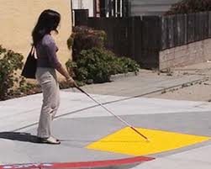
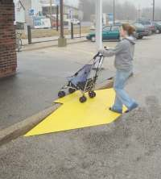
Why accessibility?
Just as we designed accessibility for the physical environment, we need it for the digital one.
Notes:
The curb cuts that benefit all of us exist for accessibility purposes.

Slide 9
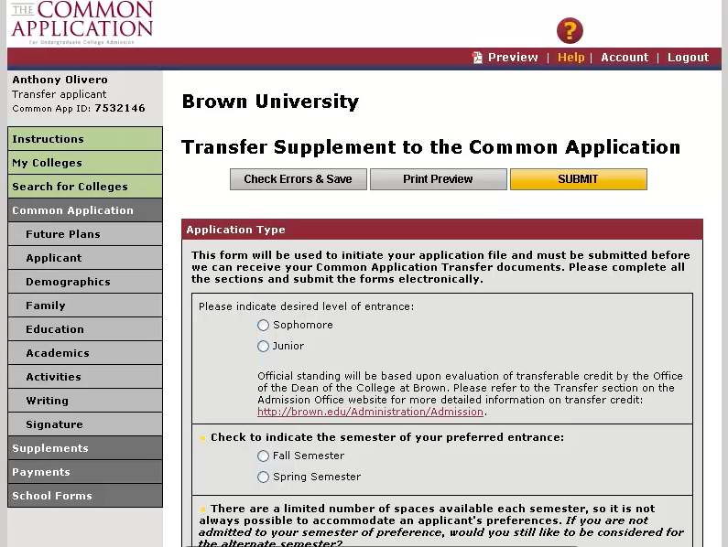
One example of inaccessibility
Filmed in 2011, courtesy of the National Federation of the Blind
Notes:
-Click on the image for a link to the video in this folder. This video is approximately 9 minutes long and demonstrates three inaccessible environments commonly used in higher ed: the Common Application interface, a math quiz, and Google Docs. You may want to just show the first two examples (stop at 05:49, before the Google Docs example).
-You will need to unzip this folder in order to play the included file.
-Other videos that might be of interest can be found at http://ncdae.org/blog/accessibility-video-playlist/ . Two of our favorites are “To Care and Comply” (http://www.youtube.com/watch?v=r_O8JIw_ryU) and “A Personal Look at Accessibility in Higher Education” (http://www.youtube.com/watch?feature=player_detailpage&v=PQGFshzLPXE).

Slide 10
Why should I consider accessible design?
It is the right thing to do
It is the smart thing to do
It is the law

Slide 11
It is the RIGHT thing to do for our institution
Provides the basis for inclusion in our digital society
The ethical and moral argument is what many of our efforts, and our network, are based on

Slide 12
It is the SMART thing to do for our institution
Reflects institutional mission, leadership, and values
Compatible with mobile and emerging technologies
Good for ALL users (students, faculty, staff, community, donors)
May become important to accrediting bodies in the future
Good PR

Slide 13
Web accessibility and mission statements
86% of institutional mission statements contain language supportive of web accessibility,
including terms like:
  “Diversity”
  “Inclusion”
  “Equality”
  “All students”
-2008 GOALS study

Slide 14
Let’s look at our mission statement
Paste your institution’s mission statement here
Notes:
If your mission statement includes this kind of language, paste it into this slide and discuss. If not, remove this slide, and possibly the previous slide.

Slide 15
Many accessibility techniques benefit others:
Older users
Mobile devices
Rural areas with lower bandwidth
Search engines
Everyone!

Slide 16
Google is blind
...and deaf
...and cannot use a mouse
Notes:
Content that is accessible is often much more search engine friendly

Slide 17
It is the LAW
“There is no doubt that the Internet sites of state and local government entities are covered by Title II of the ADA. Similarly, there is no doubt that the websites of recipients of federal financial assistance are covered by Section 504 of the Rehabilitation Act.”
-Department of Justice

Slide 18
Whitehouse letter to all colleges and universities
“It is unacceptable for universities to use emerging technology without insisting that this technology be accessible to all students.”
-Whitehouse blog

Slide 19
Examples of campus litigation
Arizona State University
Case Western Reserve University
Darden School of Business at the University of Virginia
Florida State University
Maricopa Community College District for inaccessible technology
New York University
Northwestern University
Pace University
Penn State University
Princeton University
Reed College
University of Montana
The Law School Admissions Council (serving over 200 campuses).
http://ncdae.org/blog/recent-legal-issues/

Slide 20

The cost of litigation is high!
The costs to the Institution in the case of Florida State were in excess of $400,000!
Not to mention the cost of bad publicity…

Slide 21


So what can we do?
Project GOALS has developed a Benchmarking and Planning Tool specifically tailored to help postsecondary institutions evaluate, plan for and achieve enterprise-wide web accessibility.
ncdae.org/goals
Notes:
Participation is free at the time this presentation was created (2013), please check with GOALS before the presentation to see the cost and terms of participation.

Slide 22

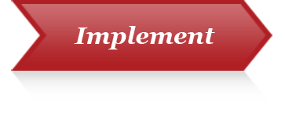

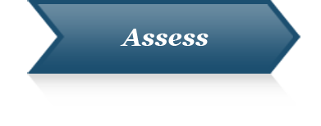
Indicators for Institutional Web Accessibility
The tool is divided into four steps or “Indicators”
that demonstrate institutional support for web accessibility.
These Indicators are:
Indicator #1: Institutional Vision and Leadership Commitment
Indicator #2: Planning and Implementation
Indicator #3: Resources and Support
Indicator #4: Assessment

Slide 23
2-Step Process
1
Each of these four indicators are addressed
in the first step in the tool, the Benchmarking portion. Institutions evaluate their current accessibility efforts through self-study.
2
The second step in the tool, the Planning portion, provides tools and resources to create a plan of action to improve our institution’s web accessibility standing.

Slide 24
Other Resources from GOALS
Accessibility “cheatsheets” on topics like Word, PowerPoint, Acrobat, etc.
Articles on implementation
Templates for creating Policies, etc.
Action Paper
Much more
All free!

Slide 25
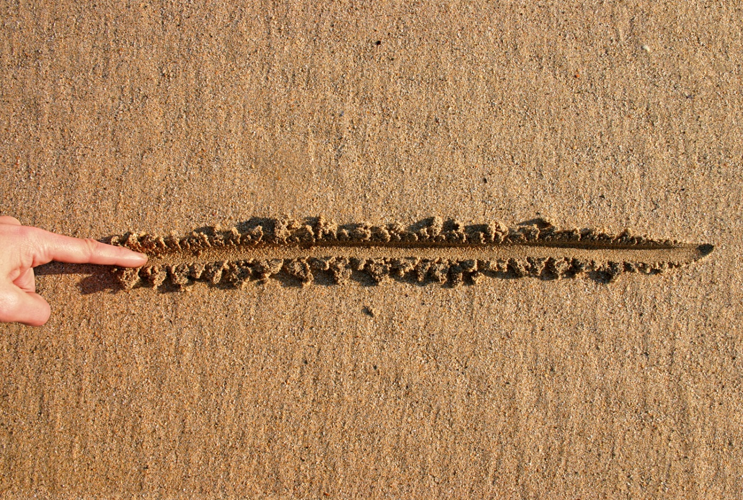
So what can I do?
Notes:
Determine today to start ensure that your content is more accessible for people with disabilities.

Slide 26
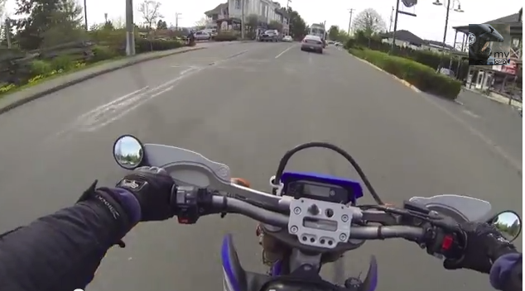
It only takes a minute
Notes:
1 minute video of a man who takes the time to pull over and help a person whose wheelchair has become stuck. Very brief but powerful.
URL - http://www.youtube.com/watch?v=mCR1Zu5hHgk

Slide 27

Thank you!
Questions?
Comments?
Next steps?
© 2013 Project GOALS All rights reserved.
For more information go to www.ncdae.org/goals
Contact us: goals@ncdae.org #435.797.3381
Made possible by a grant from the Fund for the Improvement of Postsecondary Education (FIPSE),
US Department of Education. No official endorsement implied.
Notes:
The top portion of this slide can be altered or removed. The GOALS logo, copyright, contact, and funding information on this slide cannot be removed.

